Slide 1
Certification of Avionics Embedded Systems
In collaboration with Marinvent Corporation
Chapter 5.2
Certification Basis and Practical Tests
presented by:
Shawn Coyle
shawn.coyle@marinvent.com

Slide 2
Qualitative Evaluation or Closed Loop Handling Qualities
Reasons For Qualitative Evaluation
Definitions And Terms
Cooper Harper Rating Scale
Flow Chart of Evaluations
Typical Qualitative Evaluation Techniques

Slide 3
Factors for Operational Suitability
Performance
  How far, how fast, takeoff distance, payload
  Hover ceiling
Systems
  Navigation accuracy, weapons accuracy
Reliability / Maintainability
  Cost of ownership, ease of keeping in the air
Handling Qualities
  Ease of use, precision that can be achieved

Slide 4
Open Loop vs. Closed Loop
Open Loop
  No attempt to achieve anything-
  put in an input and watch!
Closed Loop
  Attempt to achieve something-
    line up on a runway,
    turn to a heading

Slide 5
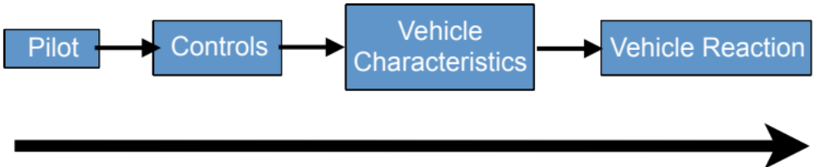
Open Loop Response
?

Slide 6
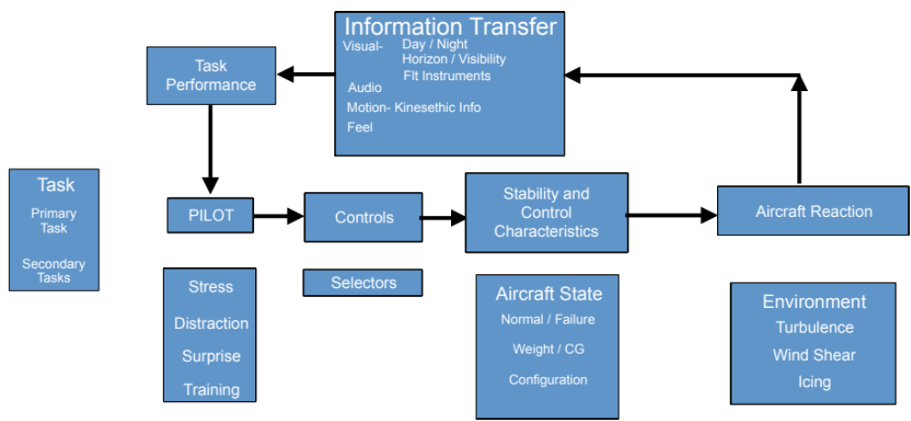
Closed Loop Task

Slide 7
All Pilots
Adaptable, Compensate well
Perceptive, non-logical thinkers
Limited response time and lag
Suffer sensor and computer overload
Surprised, disoriented or emotional
Manufactured by unskilled labor

Slide 8
Operational vs. Test Pilots
Operational Pilot
  This is difficult, therefore I am not a good pilot and must try harder
Test Pilot
  This is difficult, I am working too hard, therefore something is wrong with the aircraft or system.

Slide 9
Goal of Good Handling Qualities
User friendly aircraft
  Allows pilot to concentrate on mission tasks
    less time spent on basic flying tasks
    more time devoted to mission
  Workload decreased, task performance improved
  Safety enhanced
    compensation may suffice in low workload situations
    under stress, pilot may fail to compensate

Slide 10
What ARE Handling Qualities?
Those QUALITIES that govern the EASE and PRECISION with which the pilot is able to perform the TASKS required in prosecution of the mission.

Slide 11
The Toolbox Analogy
IF:
  All aircraft flew perfectly we would not need specifications¹
  An aircraft flies well, why measure many of the items required by the specifications?
  An aircraft does not fly well, then open the toolbox of test techniques to determine the cause of the problem
¹ Nor would we need test pilots and engineers

Slide 12
Why Qualitative Evaluation / CLHQ?
Specifications and Regulations
  Will not cover every aspect of the mission
  Are reactions to previous problems
  Do not handle new concepts in design or control (i.e., fly by wire )
  Do not address mental workload or concentration

Slide 13
More Specification Bad Points
Many areas where "Engineering" tests not possible due to:
  Danger
  Variables are not controllable
      Landing, Spinning, etc.
Specifications often treat items separately (longitudinal axis)
You must be asking yourself
  “How does this relate to Avionics???”

Slide 14
Closed Loop Solves the Problem
Covers all aspects of controlling aircraft
  Or avionics
Looks at the real problem of operating the aircraft, in total
Can cover new ideas of controlling or design
How many of you have GPS in your car?
  Do you like how it works??

Slide 15
Definitions
Define the Mission- i.e. corporate transport
Define the Flight phase – typical examples:
  Ground operations/hover
  Takeoff
  Climb
  Cruise
  Descent/approach
  Landing

Slide 16
Mission: Passenger transport
Phase
TAXI
TAKEOFF
CLIMB
CRUISE
DESCENT
APPROACH
LANDING
Elements
START
ACCELERATE
CONFIG CHG
ENROUTE CLIMB
CONFIG CHG
HOLDING
CONFIG CHG
TURN
ROTATE
CLIMB PROFILE
IFR NAV
POWER CHG
CONFIG CHG
TRANSITION VMC
STOP
ABORT T/O
AIRSPEED CHG
TURNS
AIRSPEED CHG
POWER CHG
FLIGHT PATH
ENG FAILURE
TURNS
AIRSPEED CHG
TURNS
AIRSPEED
CONTROL
ABORT
DESCENT
CHG
POWER CHGS
CONT. T/O
PROFILE
TURNS
GROUND EFFECT
CONFIG CHG
GLIDEPATH
STOPPING
NOISE ABATE
LATERAL
GO AROUND
POSITION

Slide 17
Closed Loop Handling Qualities Definitions
Mission / Role
  All functions performed to fulfill operational requirements.
Phase
  portion of a flight or mission phase
    Common Phases
      takeoff, climb, cruise, descent, approach and landing
    Special phase to mission:
      formation flight, air to air refueling, sonar dipping, NOE
Subphase
  single objective, single configuration or change in configuration
    e.g., air-to-air tracking, terminal area holding, glide slope capture, localizer capture, putting gear up or down.
:

Slide 18
Handling Qualities Definitions cont'd
Maneuver
  Planned and regulated movement for the purpose of aiding the completion of a given control task
    Bank, turn, pull-up, turn reversal, maintenance of a steady condition.
Task
  The actual work assigned to the pilot to be performed in the completion of, or as a representative of a designated flight segment

Slide 19
Still More Definitions
Workload
  The integrated mental and physical effort required to perform a specific piloting task
Performance
  The precision of control with respect to aircraft movement that the pilot is able to achieve in performing a task. (a better term might be accuracy)
Compensation
  The additional pilot effort and attention required to maintain a given level of performance (or accuracy) in the light of deficient vehicle characteristics

Slide 20
Gain
Rate of information update or feedback
  Low Gain
    Tactical Formation
  High Gain
    Tight Formation flying
It may be necessary to artificially drive up the gain to find problems that would not otherwise be found
  Slalom through cones
  Grippen, F-22

Slide 21
Maintenance Tasks
The pilot maintains a condition. Typically, this should have a time set for maintaining the condition
  i.e. cruise for 15 minutes, or cruise for 12 hours, hover for 1 hour.
  The pilot would normally expect to make small controls inputs to maintain the condition
Repeatability
  what is to be maintained,
  for how long is it to be maintained
  how accurately is it to be maintained.

Slide 22
Closed Loop Handling Qualities As a Discipline
Often viewed As:
  Undisciplined
  Illogical
  Subjective (extremely)
  Mostly black magic
No theoretical basis
  Unlike other ‘engineering’ tests
But:
  If carried out with set, repeatable tasks, under specified conditions, CLHQ is as statistically repeatable as any other engineering test.

Slide 23
Basics of Closed Loop Handling Qualities Evaluations
Test Validity
  The tests must be valid and representative of maneuvers to be done in the mission, with a proper accuracy and gain
Test Repeatability
  Tests must be described in sufficient accuracy to make them repeatable
Description vs. Assessment
  Description is not evaluation.
  Assessment is the considered opinion of the pilot of the degree of difficulty in performing the task.
  Use instrumentation or data recordings to help describe what was done, but do not make this the reason for the problem.

Slide 24
Desired vs. Adequate Performance
Desired Performance
  Ideal accuracy, or tolerance for doing the task- as quickly or precisely or smoothly as could be wanted
Adequate Performance
  Less than optimum performance, accuracy or tolerance
  Task could be done, but not as nicely as wanted
  Still satisfactory for the mission, but detracts from optimum

Slide 25
Example of Performance Definition
TASK Level Cruise, calm winds
Desired Adequate
Height ±10 ft ± 50 ft
Airspeed ± 3 KIAS ± 5 KIAS
Heading ± 3° ± 5°
  Starts when established in cruise.
  Duration of task must be specified

Slide 26
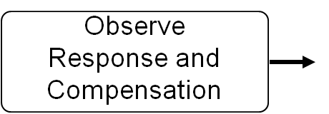
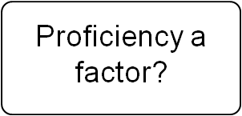
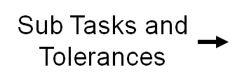
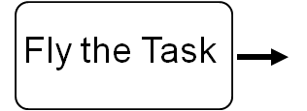
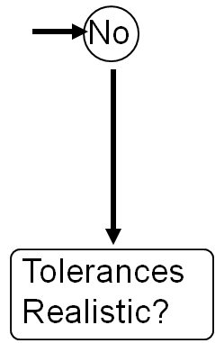
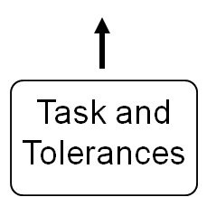
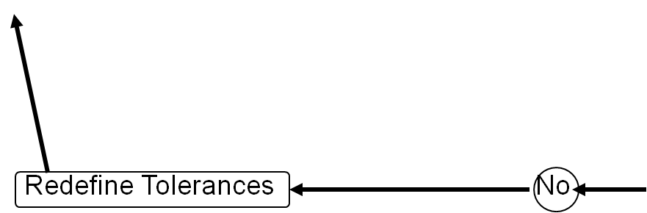
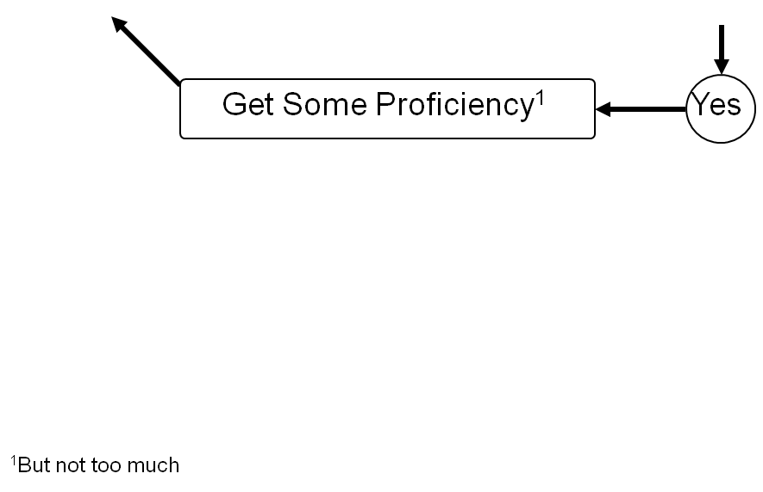
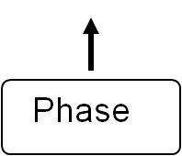
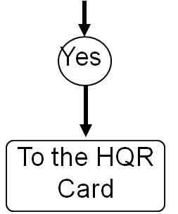
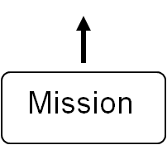
Qualitative Evaluation Flowchart or
(Getting to the HQR Card)

Slide 27
Cooper Harper Scale in General
A series of dichotomous decisions leads to a numerical rating
  Uncontrollable or Controllable?
  Control in Question?
  Pilot Compensation Adequate?
  Desired or Adequate Performance?
  Satisfactory or Not Satisfactory?

Slide 28
Excellent Highly desirable
Pilot compensation not a factor for desired performance
1
Good Negligible deficiencies
Pilot compensation not a factor for desired performance
2
Yes
Fair - Some mildly unpleasant deficiencies
Minimal pilot compensation required for desired performance
3
Is it satisfactory without improvement?
Minor but annoying deficiencies
Desired performance requires moderate pilot compensation
4
No
Moderately objectionable deficiencies
Adequate performance requires considerable pilot compensation
5
Very objectionable but tolerable deficiencies
Adequate performance requires extensive pilot compensation
6
Yes
Major deficiencies
Adequate performance not attainable with maximum tolerable pilot compensation.
7
Is adequate Performance attainable with a tolerable pilot workload?
No
Major deficiencies
Considerable pilot compensation is required for control
8
Major deficiencies
Intense pilot compensation is required to retain control
9
Yes
Is it controllable?
No
Major deficiencies
Control will be lost during some portion of required operation
10
Pilot decisions

Slide 29
Excellent Highly desirable
Pilot compensation not a factor for desired performance
1
Good Negligible deficiencies
Pilot compensation not a factor for desired performance
2
Yes
Fair - Some mildly unpleasant deficiencies
Minimal pilot compensation required for desired performance
3
Is it satisfactory without improvement?
Minor but annoying deficiencies
Desired performance requires moderate pilot compensation
4
No
Moderately objectionable deficiencies
Adequate performance requires considerable pilot compensation
5
Very objectionable but tolerable deficiencies
Adequate performance requires extensive pilot compensation
6
Yes
Is adequate Performance attainable with a tolerable pilot workload?
Major deficiencies
Adequate performance not attainable with maximum tolerable pilot compensation.
7
No
Major deficiencies
Considerable pilot compensation is required for control
8
Major deficiencies
Intense pilot compensation is required to retain control
9
Yes
Control in Question
Is it controllable?
No
Major deficiencies
Control will be lost during some portion of required operation
10
Pilot decisions

Slide 30
Excellent Highly desirable
Pilot compensation not a factor for desired performance
1
Very Good
Good Negligible deficiencies
Pilot compensation not a factor for desired performance
2
Yes
Fair - Some mildly unpleasant deficiencies
Minimal pilot compensation required for desired performance
3
Minor but annoying deficiencies
Desired performance requires moderate pilot compensation
4
Is it satisfactory without improvement?
No
Moderately objectionable deficiencies
Adequate performance requires considerable pilot compensation
5
Very objectionable but tolerable deficiencies
Adequate performance requires extensive pilot compensation
6
Yes
Major deficiencies
Adequate performance not attainable with maximum tolerable pilot compensation.
7
Is adequate Performance attainable with a tolerable pilot workload?
No
Major deficiencies
Considerable pilot compensation is required for control
8
Control in Question
9
Major deficiencies
Intense pilot compensation is required to retain control
Yes
Is it controllable?
No
Major deficiencies
Control will be lost during some portion of required operation
10
Pilot decisions

Slide 31
Excellent Highly desirable
Pilot compensation not a factor for desired performance
1
Very Good
Good Negligible deficiencies
Pilot compensation not a factor for desired performance
2
Yes
Fair - Some mildly unpleasant deficiencies
Minimal pilot compensation required for desired performance
3
Is it satisfactory without improvement?
Minor but annoying deficiencies
Desired performance requires moderate pilot compensation
4
No
Moderately objectionable deficiencies
Adequate performance requires considerable pilot compensation
5
Very objectionable but tolerable deficiencies
Adequate performance requires extensive pilot compensation
6
Yes
Is adequate Performance attainable with a tolerable pilot workload?
Major deficiencies
Adequate performance not attainable with maximum tolerable pilot compensation.
7
No
Major deficiencies
Considerable pilot compensation is required for control
8
Control in Question
9
Major deficiencies
Intense pilot compensation is required to retain control
Yes
Is it controllable?
No
Major deficiencies
Control will be lost during some portion of required operation
10
Pilot decisions

Slide 32
Very Good
Excellent Highly desirable
Pilot compensation not a factor for desired performance
1
Good Negligible deficiencies
Pilot compensation not a factor for desired performance
2
Fair - Some mildly unpleasant deficiencies
Minimal pilot compensation required for desired performance
3
Yes
Desired Performance
Minor but annoying deficiencies
Desired performance requires moderate pilot compensation
4
Is it satisfactory without improvement?
No
Moderately objectionable deficiencies
Adequate performance requires considerable pilot compensation
5
Very objectionable but tolerable deficiencies
Adequate performance requires extensive pilot compensation
6
Yes
Major deficiencies
Adequate performance not attainable with maximum tolerable pilot compensation.
7
Is adequate Performance attainable with a tolerable pilot workload?
No
Major deficiencies
Considerable pilot compensation is required for control
8
Control in Question
Major deficiencies
Intense pilot compensation is required to retain control
9
Yes
Is it controllable?
No
Major deficiencies
Control will be lost during some portion of required operation
10
Pilot decisions

Slide 33
Very Good
Excellent Highly desirable
Pilot compensation not a factor for desired performance
1
Good Negligible deficiencies
Pilot compensation not a factor for desired performance
2
Yes
Fair - Some mildly unpleasant deficiencies
Minimal pilot compensation required for desired performance
3
Minor but annoying deficiencies
Desired performance requires moderate pilot compensation
4
Is it satisfactory without improvement?
Adequate Performance
Moderately objectionable deficiencies
Adequate performance requires considerable pilot compensation
No
5
Very objectionable but tolerable deficiencies
Adequate performance requires extensive pilot compensation
6
Yes
Major deficiencies
Adequate performance not attainable with maximum tolerable pilot compensation.
7
Is adequate Performance attainable with a tolerable pilot workload?
No
Major deficiencies
Considerable pilot compensation is required for control
8
Major deficiencies
Intense pilot compensation is required to retain control
9
Yes
Control in Question
Is it controllable?
No
Major deficiencies
Control will be lost during some portion of required operation
10
Pilot decisions

Slide 34
Half Number Ratings
Half number ratings should be avoided
Never Give 3.5, 6.5 or 9.5
  You have failed to make a decision if you do
Use others with caution!

Slide 35
Analysis of The Data
ANALYSIS of the data lies in words like:
    Easy
    Slightly difficult,
    Difficult,
    Impossible, etc.
  Emphasize if it was not possible to do the task accurately (HQR ≥5)
  Discuss the nature of the compensation - Input size, frequency, etc.
    quick
    precise
    Large movements
    Very slow, etc.
,

Slide 36
Things to avoid!
If the words appear on the HQR card
  Do not use them when writing!!
They will only confuse the reader, and not communicate anything meaningful
  what does “considerable pilot compensation” mean to you?

Slide 37
Handling Qualities "Truths"
Compliance with a specification is no guarantee of satisfactory handling qualities
It is not possible to conclude on closed loop handling qualities on the basis of open loop responses and (most) test techniques
Comments vs. Numbers
  The description of the compensation and aircraft response is more important than the number assigned.

Slide 38
More CLHQ Truths
Military Standards and other criteria are just a means to an end
  The real goal is good handling qualities
    A system could meet spec and be unsatisfactory
    It also could not meet spec and be fine
Closed loop testing establishes the system acceptability
  Task requirements-
    Repeatable
      Clearly defined standards
    Mission-oriented
    Pilot in the loop
    Require sufficient control input frequency to stress the system
    Adequate duration to differentiate transient from steady state

Slide 39
Problems Due To:
Poor Task Definition,
  No repeatability in time, accuracy etc.
Incorrect use of the HQR Scale
  Just giving a number and not using the questions
Differences between Piloting Techniques
  Will always be a problem, and not understood by those uneducated in the field

Slide 40
How does this Apply to Avionics???

Slide 41
Avionics Qualitative Testing
Airframe (performance, basic S&C) under control
>50% of current flight test time evaluating systems and integration
Sensor or computer performance also under control
Human interface (biggest problem) not easily measured

Slide 42
Qualitative Evaluation Flowchart or
(Getting to the HQR Card)

Slide 43
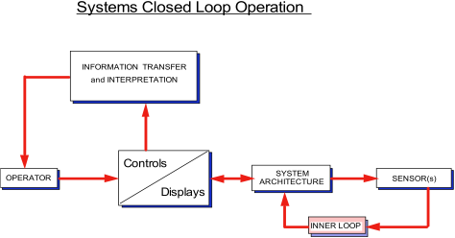
Systems Closed Loop Operation

Slide 44
Toolbox Analogy
Test Techniques are the tools used to identify the cause of a problem
  They are not the answer by themselves
For Avionics systems, the principles are the same
  just the tools haven’t all been defined...

Slide 45
Operator’s View of Avionics System
Information Transfer
Displays
Operator
Controls

Slide 46
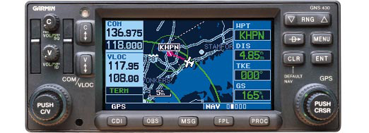
Stated More Simply...

Slide 47
What Engineers See

Slide 48
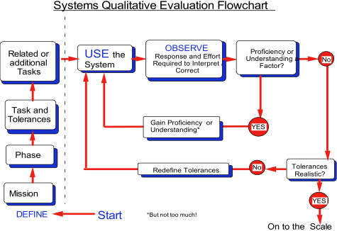

Slide 49
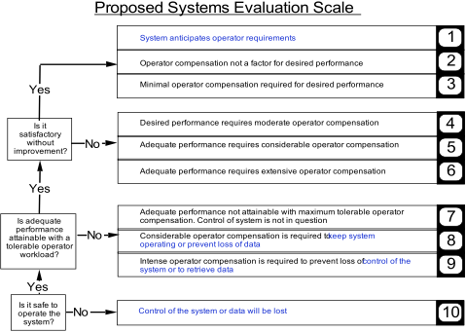

Slide 50
Unresolved Items
Adequate vs Desired Performance
  there may only be desired performance
Time may be a larger driver in systems than in handling
Interpretation of data may also be critical

Slide 51
Summary
Closed Loop Handling Techniques are Useful Tool
  For ‘handling’ of equipment
Key is repeatable task
Same Technique can be used for Avionics
  Problem is setting up tasks
  The Next Lecture!!!

